Slide 1



Statistical Foundation for RNA-Seq Analysis
Instructor: Ryan Huang
Oct. 22, 2025

Slide 2
Notes:
The McGill initiative on Computational Medicine was formed in 2017 and aims to deliver inter-disciplinary research programs and empower the use of data in health research and health care delivery
Located at the Genome Center
They have a newsletter were you can subscribe to
more info on the web site

Slide 3
Outline
Task of differential gene expression: pairwise vs multigroup comparisons
Preprocess for fair comparison: Filtering / Normalization
Statistical testing: Exact test for pairwise
Linear regression
Poisson and negative binomial distributions
Generalized linear model
Sample analysis using edgeR (R notebook)

Slide 4
Differential Gene Expression (DGE) analysis
Learning objectives:
Understand the goal of differential gene expression analysis
Understand how experimental designs affect choice of analysis methods
Know the general pipeline of DGE analysis

Slide 5
Differential Gene Expression Analysis: What?
Goal: identify differentially expressed genes (DEGs)
Determine how treatment and genotype affect expression by identifying significantly upregulated and downregulated genes
We can then analyze these identified genes to infer underlying biological mechanisms causing the variance
Common packages to perform DGE analysis:
edgeR
DESeq2
limma
Notes:
Each package differs slightly with their analysis methods

Slide 6
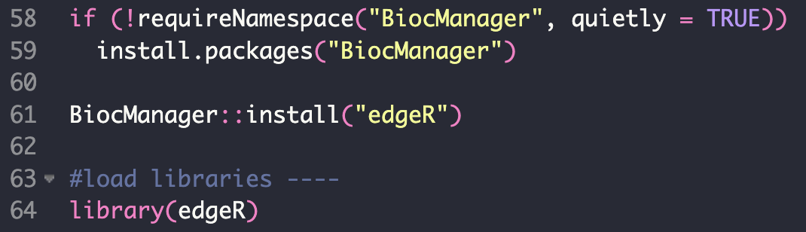
Differential Gene Expression: How? edgeR
Empirical analysis of Digital Gene Expression in R.
One of the Bioconductor packages
“The mission of the Bioconductor project is to develop, support, and disseminate free open source software that facilitates rigorous and reproducible analysis of data from current and emerging biological assays.”
Notes:
edgeR resources:
https://bioconductor.org/packages/release/bioc/vignettes/edgeR/inst/doc/edgeRUsersGuide.pdf
Robinson, Mark D et al. “edgeR: a Bioconductor package for differential expression analysis of digital gene expression data.” Bioinformatics (Oxford, England) vol. 26,1 (2010): 139-40. doi:10.1093/bioinformatics/btp616
https://www.ncbi.nlm.nih.gov/pmc/articles/PMC2796818/
McCarthy, Davis J et al. “Differential expression analysis of multifactor RNA-Seq experiments with respect to biological variation.” Nucleic acids research vol. 40,10 (2012): 4288-97. doi:10.1093/nar/gks042
https://www.ncbi.nlm.nih.gov/pmc/articles/PMC3378882/

Slide 7
How to conduct DGE analysis with edgeR:
A - Pre-processing steps:
Convert genetic data into a DGE object → allows us to use analysis functions
Filter out low count genes → focusing on genes that are more likely to be involved in the biological processes of interest
Normalize data to enable comparison → consider each sample’s library size and composition
B - Analysis steps:
Estimate the common and tag-wise dispersion
Common = overall variance
Tag-wise = gene specific variance
Perform exact test two sample groups of choice OR generalized linear model analysis

Slide 8
Preprocessing
Learning objectives:
Understand why and how we filter counts
Understand why and how we normalize counts
Understand how PCA could help with quality control

Slide 9
Filtering Genes: Why?
Remove by functional category
Ribosomal RNA
Remove genes with very low counts: genes with very low counts across all libraries provide little evidence for differential expression.
Reduces computational cost
Potentially reduces noise
Risk losing novel genes
Notes:
Enter code to complete task I and II

Slide 10
Filtering Genes: How?
As a rule of thumb, genes are dropped if they can’t possibly be expressed in all the samples for any of the conditions.
Threshold setting:
Usually, a gene is required to have a count of 5-10 in a library to be considered expressed in that library.
Multiple thresholds should be tried to find the appropriate one: account for experimental design and library size
Use counts-per-million which normalizes with library size!!!
Notes:
Enter code to complete task I and II

Slide 11
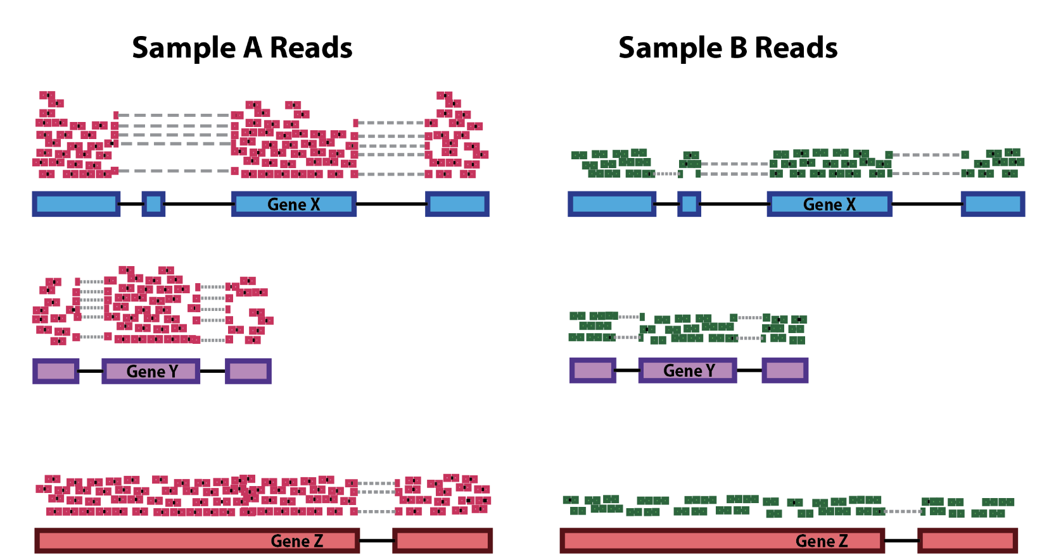
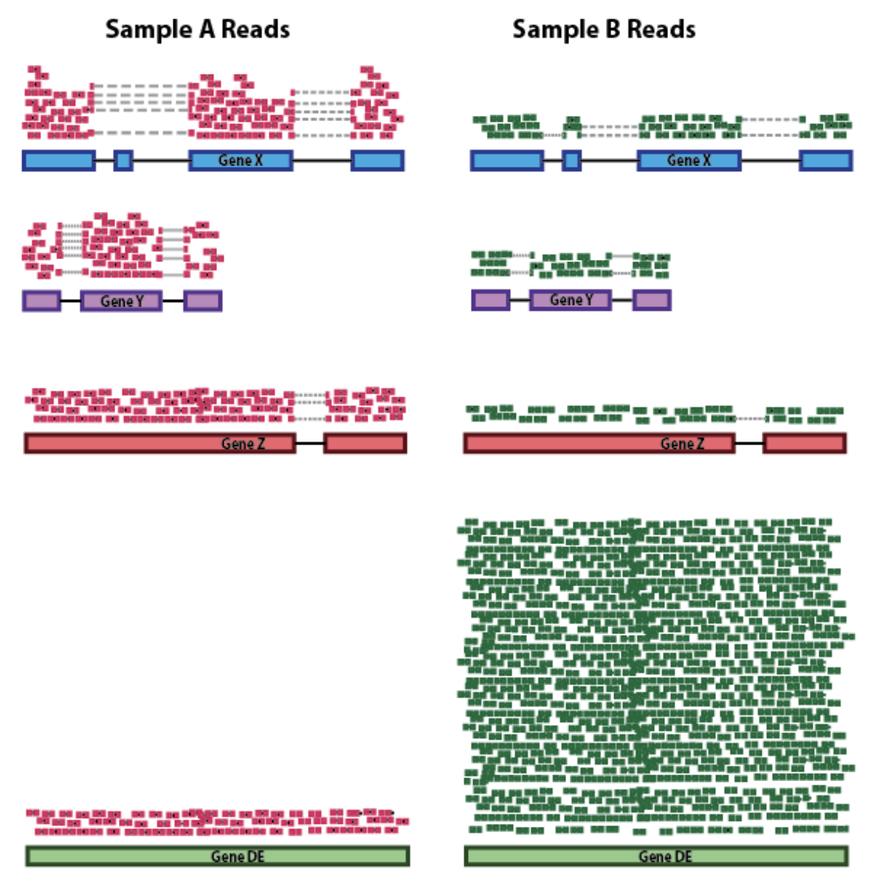
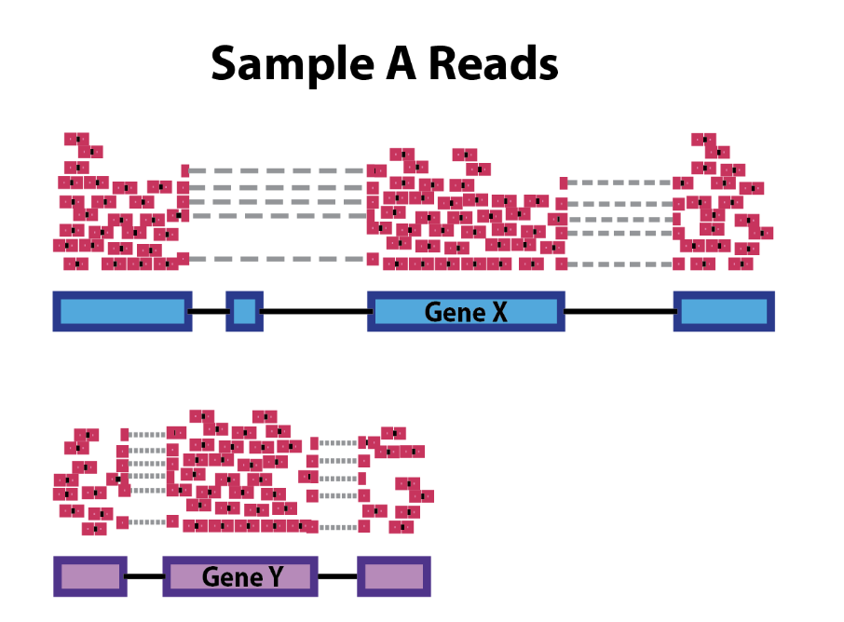
Normalization: Why?
Sequencing Depth
RNA composition
Gene length

Slide 12
Normalization: How?
What are we assuming here by using CPM?
Same total expression
Counts per million (CPM)
It normalizes RNA-seq data for sequencing depth but not gene length.
Raw counts are divided by the number of sequencing reads in your sample, multiplied by a million.
Trimmed Mean of M-values (TMM)
“RNA-seq measures relative expression rather than absolute expression. This becomes important for differential expression analyses when a small number of genes are very highly expressed in some samples but not in others. If a small proportion of highly expressed genes consume a substantial proportion of the total library size for a particular sample, this will cause the remaining genes to be under-sampled for that sample. Unless this effect is adjusted for, the remaining genes may falsely appear to be down-regulated in that sample.”
Original paper: https://genomebiology.biomedcentral.com/articles/10.1186/gb-2010-11-3-r25

Slide 13
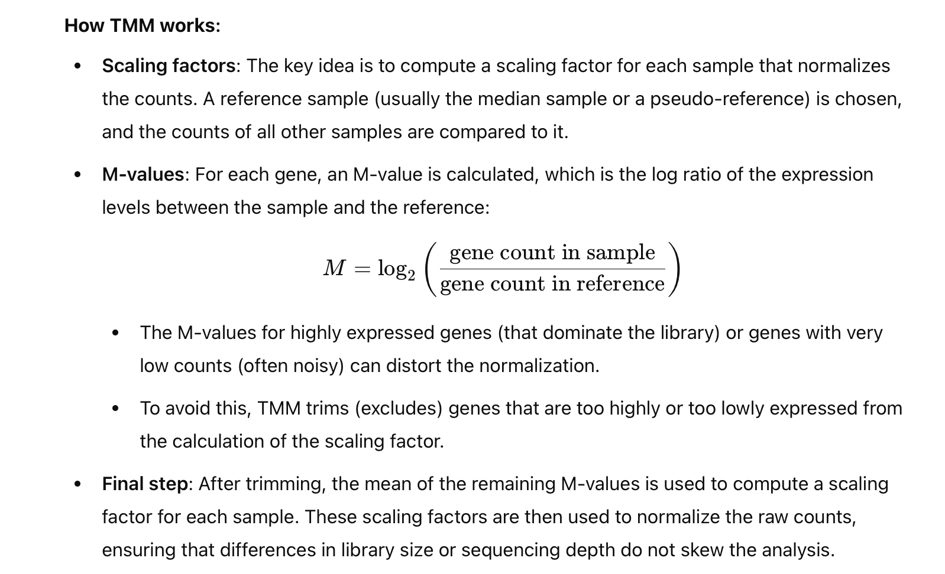
TMM: How it works?
From ChatGPT

Slide 14
Other normalization methods: Gene length
Do we need this?
Gene length is the same for all samples.
Reads per kilobase per million reads (RPKM):
RPKM is a within-sample normalization method which removes transcript-length and library size effects
First normalize by library size and then normalize by transcript length
Designed for single-end reads
Fragments per kilobase per million mapped reads (FPKM):
FPKM is an extension of RPKM designed for paired-end reads
Each pair of reads are treated as one fragment here (if they both were mapped). This avoids counting a fragment twice which cannot be done by RPKM.
Renders the same output as RPKM on single-end reads.
Transcripts per million (TPM)
TPM is an extension of RPKM where we first normalize by transcript length and then normalize by library size.
The sum of all TPMs is the same for each sample, making it easier to compare the proportion of reads mapped to a gene across samples.
Can also convert FPKM counts into TPM

Slide 15
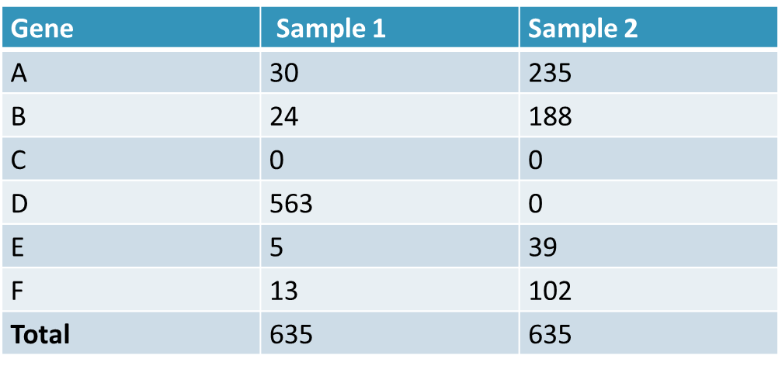
Normalization Limitations
Assume we have two identical samples
Knockout expression of Gene D in sample 2
Fixed Library size means remaining counts are redistributed over the remaining genes
In general, we don’t expect the knocked-out genes to dominate the reads.
Notes:
It is possible to see a difference in library composition in the same tissue type after the knock-out of a gene.
we have RNA-Seq counts from 2 samples (same library size: 635 reads), for a genome with 6 genes. The genes have the same expression in both samples, except one: only Sample 1 transcribes gene D, at a high level (563 reads). As the library size is the same for both samples, sample 2 has 563 extra reads to be distributed over genes A, B, C, E and F.
As a result, the read count for all genes except for genes C and D is really high in Sample 2. Nonetheless, the only differentially expressed gene is gene D.
ENTER CODE and do up until task II

Slide 16
Dimensionality Reduction:
Principal Component Analysis
Notes:
- megan Takes over presenting

Slide 17
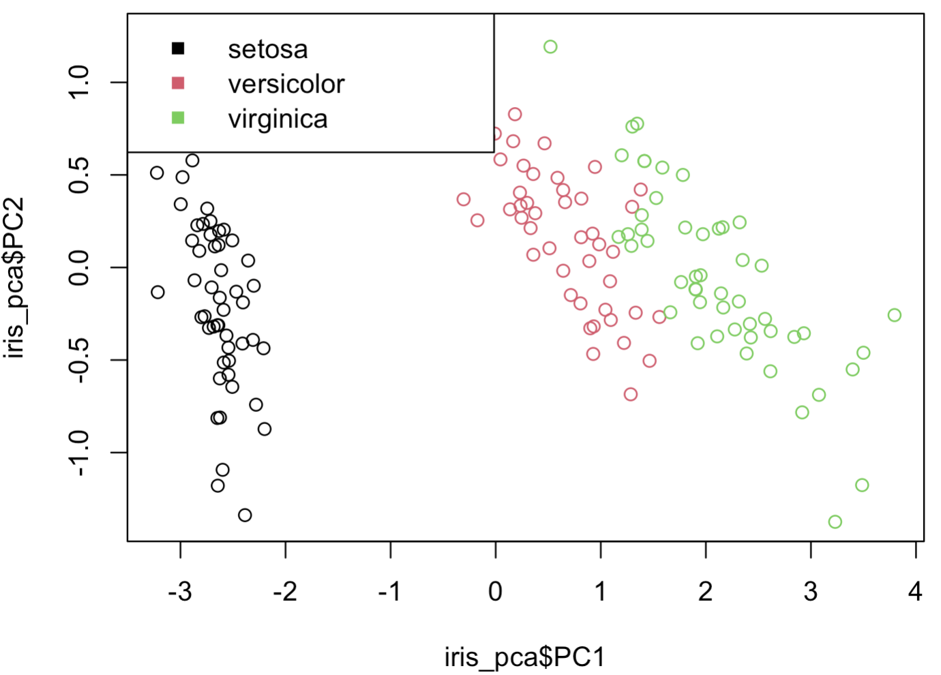
What is dimensionality reduction?
The projection of high dimensional datasets into lower dimensional spaces, while retaining the meaningful properties of the data.
Key points:
Keep most important features
Statistical significance
Correlated variables
Create new features from original features via
Linear combinations
Nonlinear combinations
(PCA)
Notes:
- I won’t be going into the math of PCA

Slide 18
Principal Component Analysis (PCA) on Gene Expression
Goal:
Determine the major contributing factors to gene expression variance between samples
How: Creates new variables called principal components (PC’s) based on linear transformations of the original variables.
PC’s capture the variance in the dataset:
PC1 is the combination of variables with the highest variance,
PC2 is the combination of variables with the 2nd highest variance,
…
Coding :
PCA input variables = gene feature counts for each sample

Slide 19
Statistical Testing
Learning objectives:
Understand the formulation and assumption of standard statistical tests
Understand the interpretation of a p-value

Slide 20
Hypothesis Tests
Goal
Determine if two sets of data are different
Can approach this with test statistics
Is the difference significant or not?
Many Types of Tests
Parametric tests – make assumptions on the data distribution
Z-score vs. t-test
ANOVA
Non-parametric – does not make assumptions on data dist.
Permutation test

Slide 21
Hypothesis Formulation
Null Hypothesis
Effect size is 0
Difference between conditions is 0
Alternative Hypothesis
Effect size is NOT 0
Difference between conditions is NOT 0
We accept or reject the null based on the generated p-value (< 0.05)

Slide 22
Understanding Significance
Statistical significance DOES NOT imply causality
It is a measurement of the likelihood of the observed data happening by chance.
A p-value tells us the probability of seeing the observation if the null hypothesis is true.

Slide 23
Dispersions and the exact test
Exact test definition:
Statistical method used to compare two groups (e.g., experimental conditions) when data doesn’t meet the assumptions of traditional statistical tests (like the t-test).
Identifies differentially expressed genes while accounting for the overdispersion of RNA-seq data
Dispersions to account for:
Common dispersion = single value that represents the average level of variability across all genes
Tag-wise dispersion = gene-specific variability based on its unique characteristics and the common dispersion
Notes:
T-test → an inferential statistic used to determine if there is a significant difference between the means of two groups and how they are related
Why we need common →
We only have 2 replicates per sample → small size
Tag-wise dispersion alone would not be a good estimate of variance

Slide 24
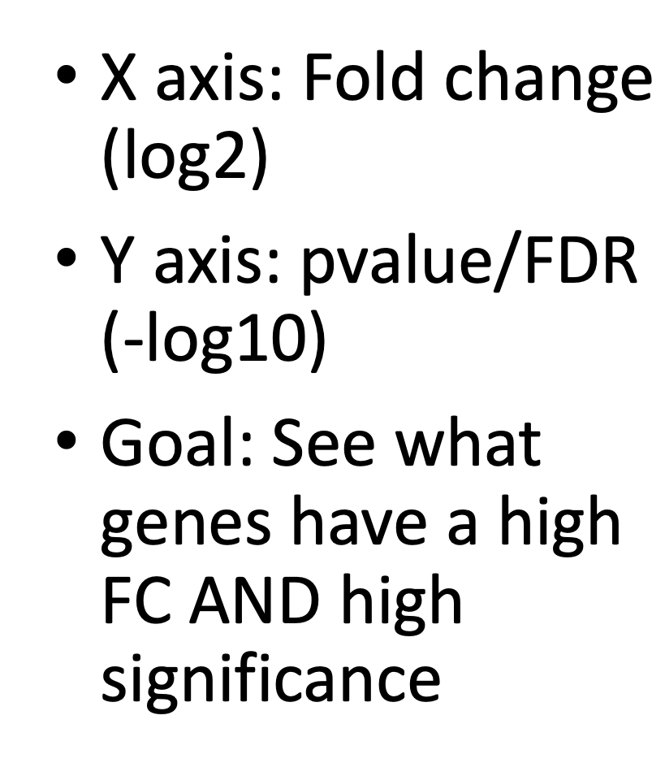
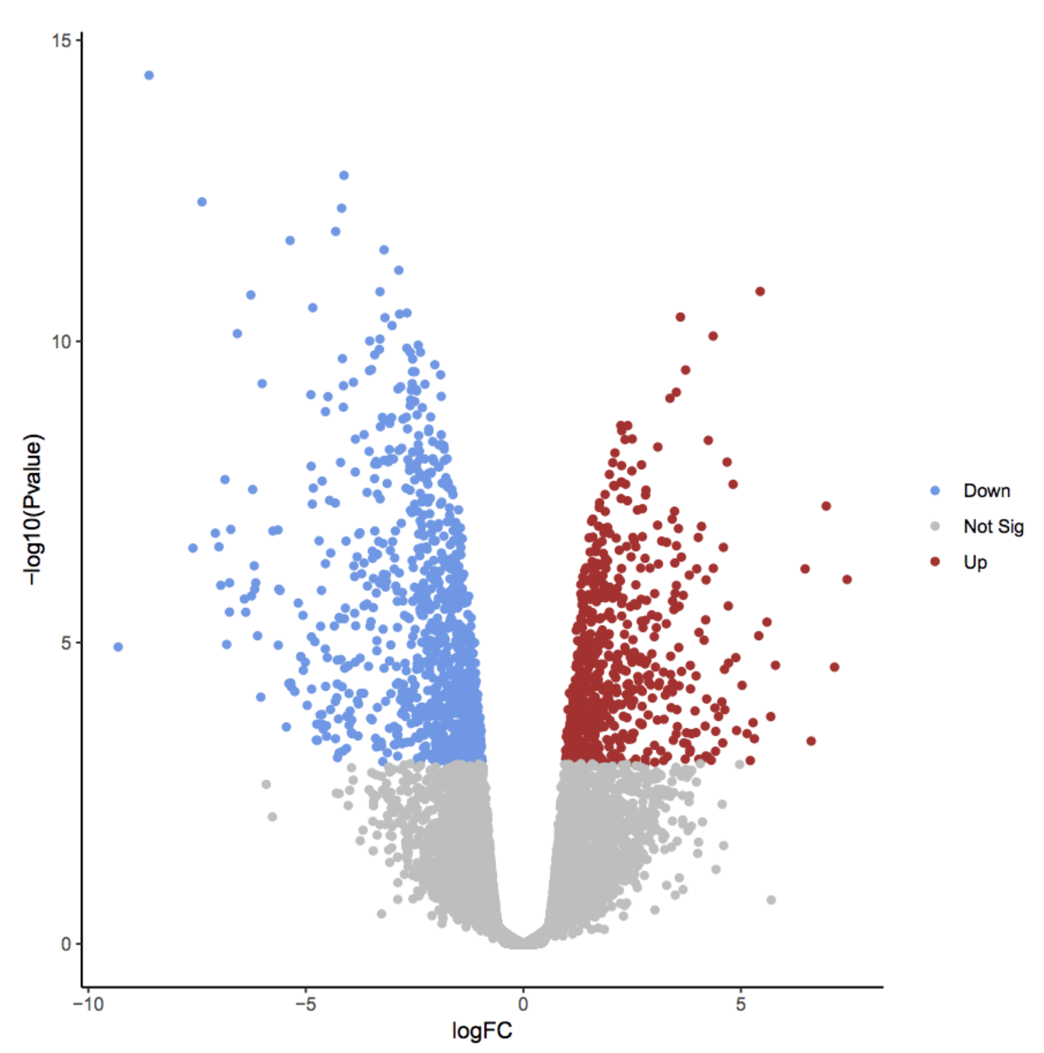
Volcano plot

Slide 25
What if we have multiple groups/dosages?
Example: test different siRNA knockdown conditions (25%, 50%, 100%) crossed with drug dosages (1 mM, 0.1 mM, 0.01 mM).
9 groups, how many pair-wise?
Solution: regression

Slide 26
Linear Regression
Learning objectives:
Understand the fundamental regression algorithms
What is a coefficient/effect size

Slide 27
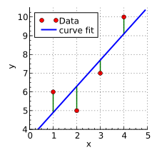
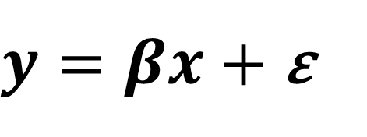

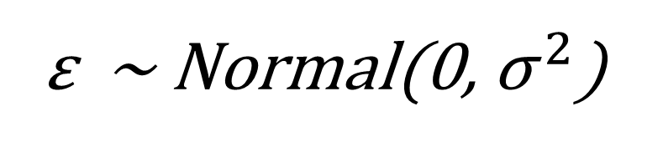
The Linear Model
Credit: Wikipedia
The fundamental model for statistics & machine learning
Follows a Normal distribution
Imagine a dataset with a dependent variable y and a set of descriptive features x
We want to learn what features in x are good predictors of y (what is their effect size/coefficient β)
$y=βx$ $+$ ε
ε ~ Normal(0, ${\text{σ}}^{ 2}$)
y ~ Normal(βx, ${\text{σ}}^{ 2}$)

Slide 28
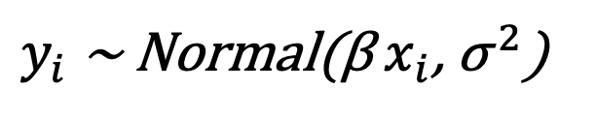
Model Assumptions
Outcome is continuous and a linear combination of predictors
Outcome is such that
Predictors must not be perfectly correlated (linear combination)
For every observation i the error is:
Normally distributed
Mean zero
Homoskedastic (same variance as other observations)
Independent (not correlated)
$y_{i}$ ~ Normal(β $x_{i}$, ${\text{σ}}^{ 2}$)

Slide 29


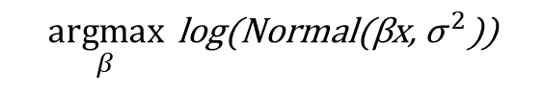

Model Fitting
Probabilistic Approach
Maximum Likelihood Estimation
Machine Learning
Mean Squared Error
$$\underset{β}{argmax}{ \text{log}\text{(}\text{Normal}\text{(}\text{β}\text{x}\text{,} {\text{σ}}^{ 2}\text{)}\text{)}}$$
$$y=βx+ε$$
$$MSE= \frac{\sum_{i=1}^{N}{{ \left(\hat{y_{i}} −y_{i}\right)}^{2}}}{N}$$
$$\hat{y}=\hat{β}x$$

Slide 30
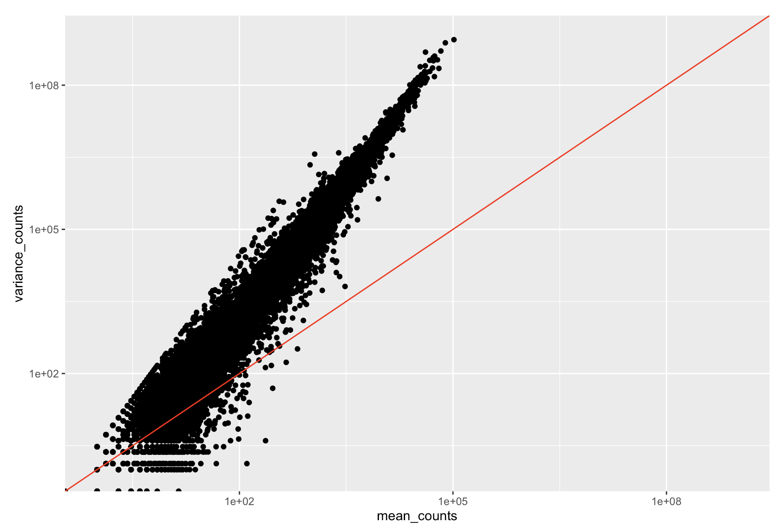
Are gene counts normally distributed? NO
Variance not fixed
Adapted from: https://hbctraining.github.io/DGE_workshop_salmon_online/schedule/links-to-lessons.html

Slide 31
Poisson and Negative Binomial
Learning objectives:
Understand properties of Poisson and negative binomial distributions
Know why we use these to model RNA-seq count data

Slide 32
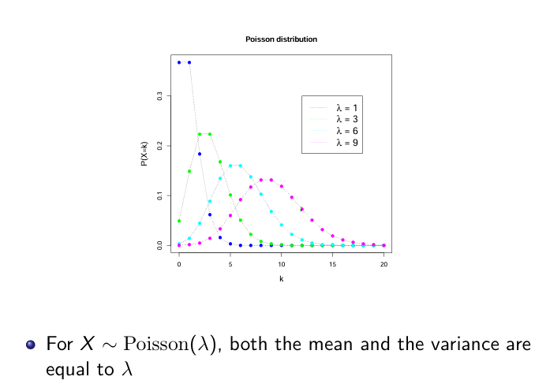
Poisson distribution
From Robinson

Slide 33
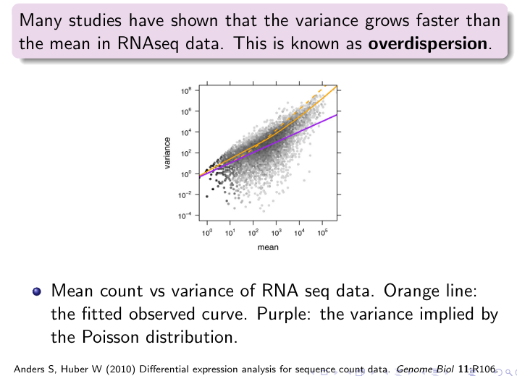
Negative binomial
From Robinson

Slide 34
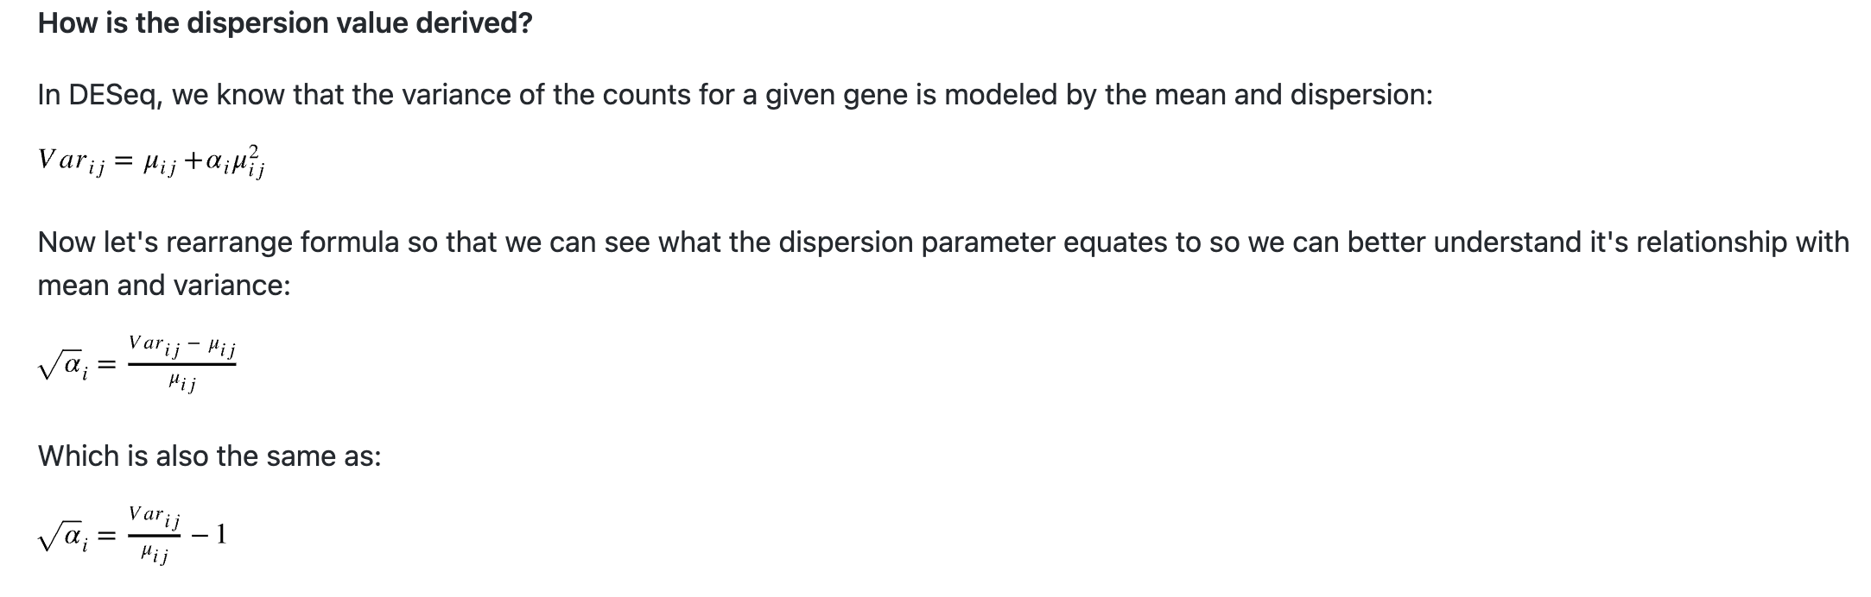
What is Dispersion?
A measure of spread or variability in the data
Rearranged:
Adapted from: https://hbctraining.github.io/DGE_workshop_salmon_online/schedule/links-to-lessons.html
Notes:
Variance, standard deviation, IQR, among other measures, can all be used to measure dispersion.
DESeq2 uses a specific measure of dispersion (α) related to the mean (μ) and variance of the data:
the square root of dispersion will be equal to the coefficient of variation (Var / μ).
dispersion is inversely related to the mean and directly related to variance.
So 0.01 dispersion means 10% variation around the mean expected across biological replicates.

Slide 35
Generalized Linear Models
Learning objectives:
Understand why and how to use generalized linear models to quantify differential gene expression

Slide 36
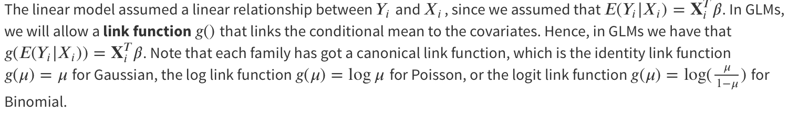
GLM Advantages
Conditional distribution: allow Poisson or negative binomial in addition to Gaussian
Link function → positive counts
E(Yi|Xi) = e^(Xi*beta) > 0

Slide 37
Compare with log-transformed Linear Regression
Linear model where Yi is log-transformed: E(log Yi), while in GLM, we have log E(Yi)
This is not the same: in GLM, we are modelling a transformed version of the expected value, and we retransform to interpret the fit in terms of the mean of the response variables (gene count)

Slide 38
GLM for DEG
Models Gene Expression using Generalized Linear Models
Assumes counts are sampled from Negative-binomial distribution
Use log as link function

Slide 39
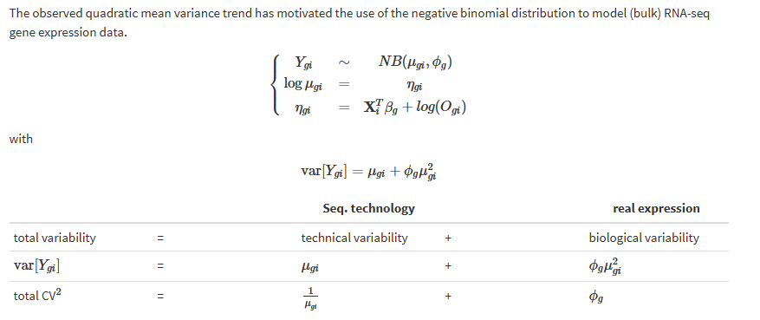
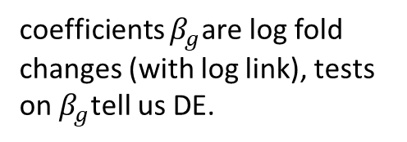
Dispersion and Variability
Anything unexplained?
coefficients $β_{g}$are log fold changes (with log link), tests on $β_{g}$tell us DE.
From Berge and Clement

Slide 40
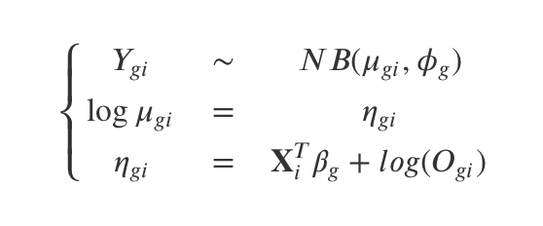
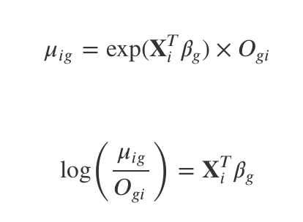
Normalization Alternatives: Offset

Slide 41
Coding Notebook in R

Slide 42
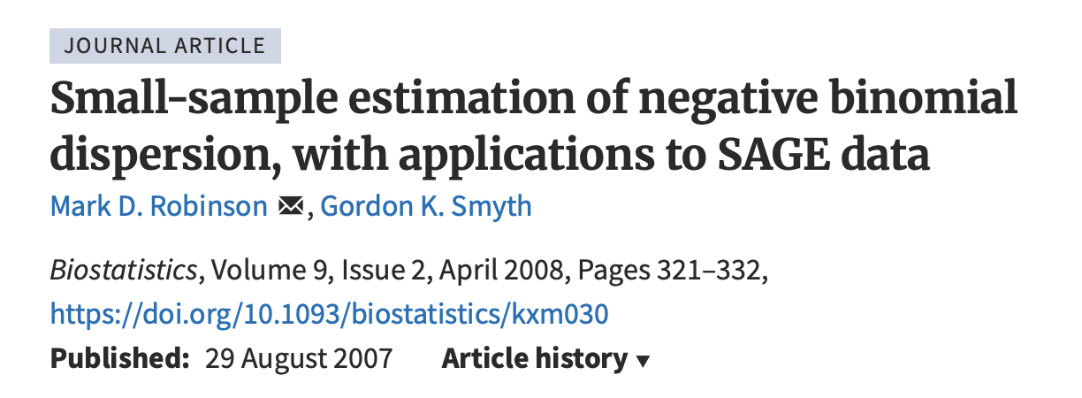

Theory: Dispersion estimation and Fitting GLM (references)

Slide 43
Acknowledgements and References
Past MiCM slides: Intro to RNA-seq and Statistics in R (Adrien Osakwe)
QLSC600 slides: myself and Megan Ng
RNA-seq lecture by Peter N. Robinson
Tutorial from Berge and Clement: https://statomics.github.io/SGA/sequencing_countData.html
Sample data from
Scheckel C, Drapeau E, Frias MA, Park CY et al. Regulatory consequences of neuronal ELAV-like protein binding to coding and non-coding RNAs in human brain. Elife 2016 Feb 19;5. PMID: 26894958

